Slide 1
Environmental Science
The best subject

Slide 2
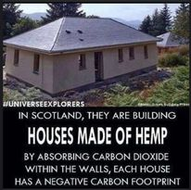
1. Environmental Science Overview
Environmental Science is an interdisciplinary science, which means it combines aspects of lots of different sciences like Biology, Chemistry and Earth sciences.
It looks at how Humans and the environment are interrelated and interconnected.
In class you participate in experiments and we go on several excursions.

Slide 3
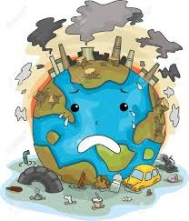
2. Unit 1 and 2
In Unit 1 & 2 we study how the Earth is a system. This means that all living and non-living things have a function in maintaining life on Earth, and each thing is important
We also look at pollution and how it affects the Earth’s systems. Part of this is monitoring and managing pollution., including water testing at the Goulburn River.

Slide 4
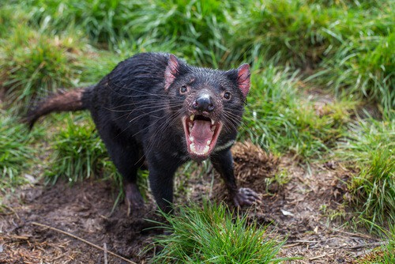
3. Unit 3 and 4
In Unit 3 & 4 we look further into Biodiversity – why it is important and how we can develop our world but maintain biodiversity.
Finally we look at the impact of different types of energy sources. The good, the bad and the ugly. We finish this by deciding on a sustainable mix of energy sources.

Slide 5
Why you should select Enviro
Every job in the world will soon have an Environmental Science slant. It is so important to have an understanding about what is happening to the Earth.
Studying Environmental Science allows you to work in the CSIRO, Federal or State government conducting research, managing natural resources, managing environmental footprints for big organisations, advise policy makers, help save the Great Barrier Reef, conduct research in Antarctica, work in Ecotourism, work for Parks and Wildlife.
HELP SAVE THE PLANET – IT’S THE ONLY ONE WE HAVE

