Slide 1
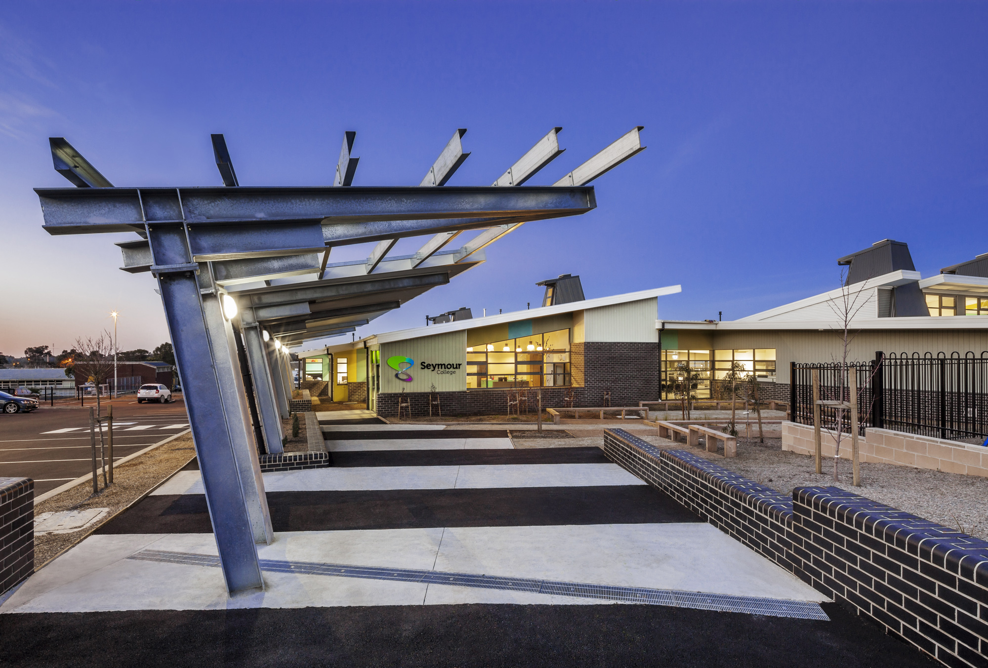
Victorian
Pathways
Certificate
Respect – Inspire - Excel

Slide 2
Introduction to the Victorian Pathways Certificate

Slide 3
Why VPC?
The VPC is designed to develop and extend pathways for young people while providing flexibility for different cohorts.
After completing the VPC, students will be able to make informed choices about future employment or education pathways.

Slide 4
Why VPC?
The VPC aims to:
equip students with the skills, knowledge, values and capabilities to be active and informed citizens, lifelong learners and confident and creative individuals
empower students to make informed decisions about the next stages of their lives through authentic workplace experiences
provide them with the best opportunity to achieve their personal goals and aspirations in a rapidly changing world.

Slide 5
Should I choose VPC?
A valuable option for students seeking a high-quality vocational pathway
For motivated students who are not interested in immediately pursuing a university education after school
For students who are serious about pursuing TAFE or employment after school
An opportunity to connect theory to application, by linking academic work with real life applications

Slide 6
VPC Requires
Completion of 12 units (this may include VET or VM Subjects)
High attendance level
High participation level
All required tasks to be completed to a high standard
Completion of multiple Work Experience placements is highly recommended

Slide 7
Should I choose VPC?
For students who understand that the last two years of school are important for:
Being equipped for TAFE
Being equipped for work
Social / emotional / character development
Building a sense of identity and self-esteem

Slide 8
VPC Structure
Year 11 and 12 Seymour VPC students will attend Seymour College 5 days in 2025. They will complete the 4 core VPC subjects.
VPC Students may be able to participate in:
1 or 2 VM subjects (negotiated)
VPC Students may be able to complete:
1 day of VET (negotiated)
1 day at SWL (negotiated)

Slide 9
VPC Voluntary Short Courses
VPC allows students the opportunity to complete short courses that will benefit them in the work force. Short courses delivered to VPC students over the last two years include:
White Card
RSA
Food Handling
Safe @ Work (OHS)
First Aid
Road Safety Skills

Slide 10
VCE Vocational Major
The Victorian Pathways Certificate
The VPC is a pathway to completing your senior education with a focus on employment and TAFE pathways. It includes an applied learning pedagogy.
Areas of compulsory study:
Literacy
Numeracy
Work Related Skills
Personal Development Skills
Areas of voluntary study:
VET
SWL
Work Experience
Short Courses
Notes:
One of the main benefits of the VCE Vocational Major is its emphasis on practical work-related skills, with two of the four strands focusing on providing practical work and industry experience. Students are able to focus on a specific industry by completing a VET qualification.
It provides students with the opportunity to develop ‘employability skills’ which can be used as a pathway into
further training at TAFE Colleges, other training providers
Industry related training via Apprenticeships / Traineeships
Employment linked to training
Opportunities to build personal skills and work related skills that are important for life and work
Our VCE Vocational Major does not meet the immediate entry requirements for University and does not provide an ATAR ranking

Slide 11
VPC Subjects
VPC Subject | Areas of Study
Literacy | Literacy for Personal Use Understanding and Creating Digital Texts Exploring and Understanding Issues and Voices Informed Discussion Literacy for Civic Participation Literacy for Pathways and Further Learning Negotiated Project

Slide 12
VPC Subjects
VPC Subject | Areas of Study
Numeracy | Personal Numeracy Systematics Number Change Shape Quantity and Measure Data Likelihood

Slide 13
VPC Subjects
VPC Subject | Areas of Study
Work Related Skills | Interests, Skills and Capabilities in the Workplace Employment Opportunities and Workplace Conditions Applying for Equal Opportunity Identifying and Planning for a Work Related Activity Completing and Reviewing a Small Scale Work Related Activity Reporting on a Small Scale Work Related Activity Healthy Workplace Practices Rights and Responsibilities Physical Health and Safety Explore and Plan Potential Pathways Employment Seeking Activities and the Application Process Practice Job Interview

Slide 14
VPC Subjects
VPC Subject | Areas of Study
Personal Development Skills | Understanding Self Developing Self Exploring and Connecting with the Community Community Participation Collaborate and Negotiate Motivate and Lead Community Awareness Project Community Participation

