Slide 1
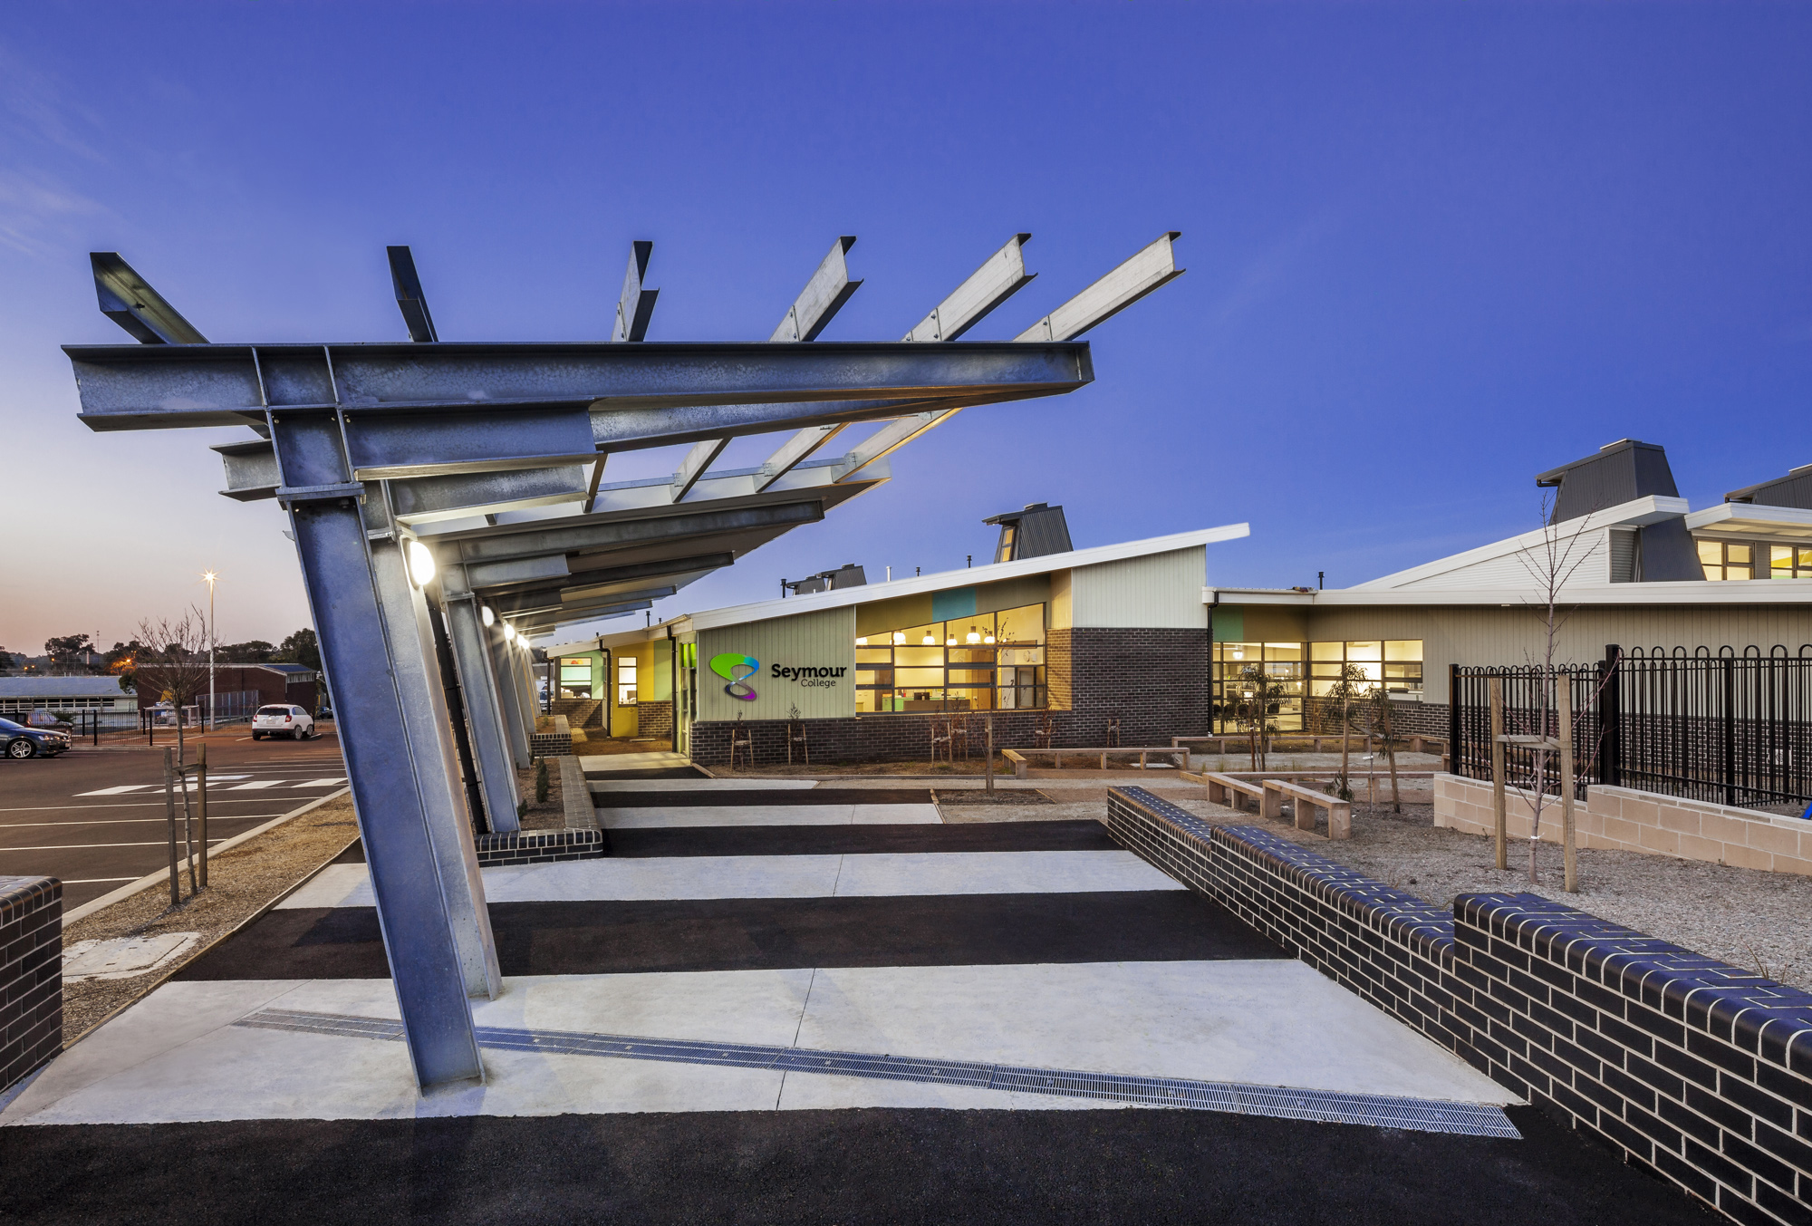
Seymour College: Senior Information Session 2024
VCE Co-Ordinator – Sharon Hill
Respect – Inspire - Excel

Slide 2
Seymour College Senior School
WE OFFER:
VCE(Victorian Certificate of Education)
VCE/VM(Vocational Major)
VPC(Victorian Pathways Certificate)
VET(Vocational Education and Training)
SBATs(School Based Apprenticeships and Traineeships)
VCE Senior Secondary Completion rate 2023: 100%
4 year average: 98.5%
Alumnus in the spotlight: Chief Commissioner of Victoria Police, Shane Patton

Slide 3
Choosing a senior pathway
As a Year 10 student about to choose your VCE(Victorian Certificate of Education) or VCE VM(Vocational Major) study program, the choices can seem a little overwhelming
Your careers advisors Ms. Wilmot and Mrs. Fisher are a very good place to start these discussions. We will be holding pathways interviews on Monday, the 12th of August with year 10 students and their caregivers
However, ultimately your options are either: VCE or the VCE VM. VET is an option within both courses

Slide 4
Senior School Pathways
VCE: Victorian Certificate of Education
For students who may wish to access University
or TAFE studies
Provides a tertiary entrance ranking (ATAR)
State wide certificate done over two years
Leads to:
Employment, traineeships, apprenticeships, TAFE and University studies
Can include VET studies such as Automotive, Engineering, Building and Hospitality for example
VCE VM: Victorian Certificate of Education Vocational Major
For students seeking employment
Cannot provide access to University study
State wide certificate done over two years
Leads to:
Employment, some apprenticeships and traineeships, some TAFE courses
Must include VET studies

Slide 5
VET: Vocational Education and Training
For students in either VCE or VCE VM, seeking trade or technical training
One day per week, either at Seymour College or at TAFE venues
National qualification, usually Certificate 2: two years
Leads to:
Trade or technical qualification
traineeships, TAFE studies, apprenticeships, employment
Can count as credit towards a future apprenticeship

Slide 6
Victorian Certificate of Education
At Seymour College we offer a wide range of VCE units
English(including English as an Additional Language)
English Literature
General Mathematics
Mathematical Methods
Physics
Chemistry
Biology
Environmental Science
Agricultural and Horticultural Studies
Psychology
Legal Studies
History
Business Management
Health and Human Development
Physical Education
Art Creative Practice
Visual Communication and Design
Media
Product Design and Technology

Slide 7
VCE Structure
Students at Seymour College typically
study 22 units over two years(12 in year 11 and
10 in year 12)
Some of these subjects can be VET units
Year 9 students can be invited to fast track a VCE subject and undertake VET

Slide 8
How do I obtain my VCE?
You must satisfactorily complete at least 16 units over two years
At least 3 units must be from the English group
Year 11 is assessed by the school and year 12 is a combination of assessments from teachers and an external exam run by the VCAA(Victorian Curriculum and Assessment Authority)

Slide 9
What does all this mean?
At the end of year 12 you will receive a study score for each subject and an ATAR(Australian Tertiary Admission Rank) to enable you to apply for universities
To get a good ATAR, you should therefore pick studies which interest you and in which you can perform well
Be wary of choosing VCE studies only because you think they will maximise your ATAR

Slide 10
Tertiary Entrance 2027
Students beginning VCE in 2025 will begin tertiary studies in 2027. “A Guide For Year 10 Students” has already been published and links forwarded to students and families
This is available for download off the VTAC(Victorian Tertiary Admissions Centre) website

Slide 11
Timeline
Students will begin choosing their pathways over the next weeks in conjunction with their careers advisors Ms Wilmot and Mrs Fisher, the VCE Co-ordinator, Ms. Hill, Ms. McLarty and Mr. Stute, the year 10 Co-Ordinators and Mr. Rimes, Assistant Principal

Slide 12
Places to go for information
VICTORIAN TERTIARY ADMISSIONS CENTRE
http://www.vtac.edu.au/
http://www.vtac.edu.au/CourseSearch/searchguide.htm
VICTORIAN CURRICULUM ASSESSMENT AUTHORITY
http://www.vcaa.vic.edu.au/
http://www.vcaa.vic.edu.au/vce/index.html
SEYMOUR COLLEGE WEBSITE
http://www.seymourcollege.vic.edu.au
SUBJECT TEACHERS and THE PATHWAYS INTERVIEWS

