Slide 1
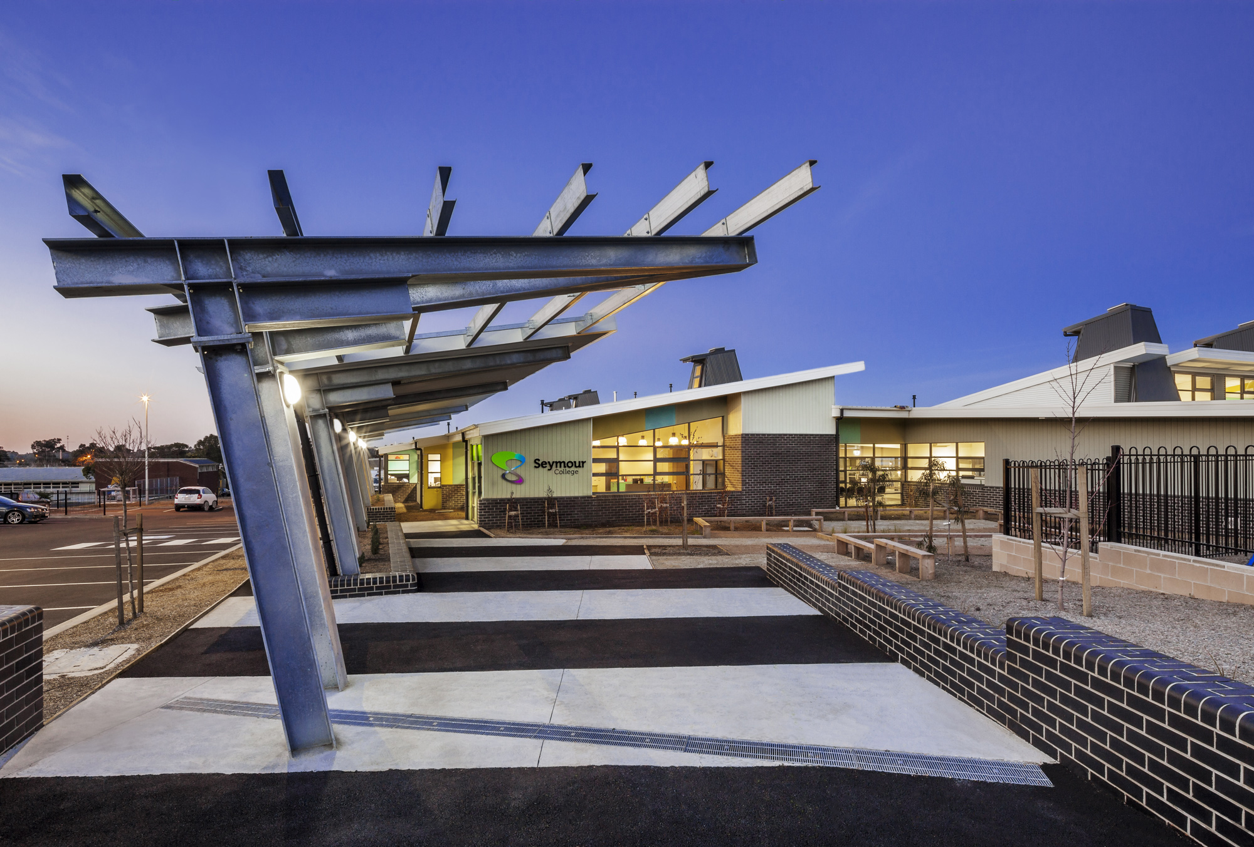
Seymour College: VCE VM Information Session 2024
The VCE VM overview will be provided by Lisa Macheras and Leanne Hayek
Respect – Inspire - Excel

Slide 2
2025 year 11 VM Structure at Seymour College
VCE Vocational Major is a pathway to completing your senior education with a focus on trades, traineeships and TAFE pathways.
Will attend Seymour College 4 days per week in 2025
1 day at their external VET.
Will complete the 4 VM subjects (Literacy, Numeracy, Personal Development Skills, Work related skills)
Will complete 1 VCE subject
Will complete SWL (Structured Workplace Learning) in block placement.

Slide 3
VM is…
Based on the old VCAL, which replaced technical schools.
A valuable option for students seeking a high-quality vocational pathway
For students who know their pathway and want to get started on it.
Connecting theory to application, providing real life learning experiences in and outside the classroom
The development of employability skills
Giving students more independence with their learning
Students who are wanting to do VET and work placement which are both compulsory.

Slide 4
VM is NOT
The easy option
Always for disengaged students
Always ‘hands on’ or kinesthetic
Meeting the immediate entry requirements for many University courses, and does not provide an ATAR ranking
For people who do not want to do work outside the classroom with the community – Essential in Personal Development for practising our employability skills.
For students who are not committed. Students in VM must successfully pass each subject in order to achieve their VM
For students who don’t like leaving the school – we go on a number of excursions that are compulsory.

Slide 5
What to do if you want to apply for VM at Seymour College?
Complete as much work placement in Year 10 as you can in a different areas (You must have completed work placement to apply for VM)
Research VET courses and apply for VET by the 26th of August (See the Careers office ASAP about this)
Participate in the training interviews in term 4
Attend subject selection day (12th August)
Sit a VM interview
Your positive school engagement and your attendance in Year 10 will be a factor when determining applications.

